Slide 1

Categorical Data

Slide 2
Types of Variables
There are two basic types of variables: numerical and categorical variables.
Numerical Variables: variables to which a number is assigned as a quantitative value.
Categorical Variables: variables defined by the classes or categories into which an individual member falls.
3 - <number>

Slide 3
Categorical Variables
Defined by the classes or categories into which an individual member falls.
Nominal Scale: Name only--Gender, hair color, ethnicity
Ordinal Scale: Nominal categories with an implied order--Low, medium, high.
3 - <number>

Slide 4
Two-Sample Test for Binomial Proportions Example
A hypothesis has been proposed that breast cancer in women is caused in part by events that occur between the age at first occurrence of menstruation and the age at first childbirth.
The hypothesis is that the risk of breast cancer increases as the length of this time interval increases.
If this theory is correct, then an important risk factor for breast cancer is age at first birth

Slide 5
Two-Sample Test for Binomial Proportions Example
An international study was set up to test this hypothesis . Breast-cancer cases were identified among women in selected hospitals in the United States, Greece, and Japan.
Controls were chosen from women of comparable age who were in the hospital at the same time as the cases but who did not have breast cancer.

Slide 6
Two-Sample Test for Binomial Proportions Example
All women were asked about their age at first birth.
The set of women with at least one birth was arbitrarily divided into two categories:
  (1) women whose age at first birth was ≤29 years and
  (2) women whose age at first birth was ≥30 years.

Slide 7
Two-Sample Test for Binomial Proportions
To test whether an important risk factor for breast cancer is age at first childbirth.
p₁ = probability that age at first birth is ≥30 in case women with at least one birth
p₂ = probability that age at first birth is ≥30 in control women with at least one birth
The null Hypothesis:
H₀: p₁ =p₂
The alternative hypothesis:
H_{a}: p₁ ≠ p₂
The approach we focus on for testing the hypothesis: Contingency-Table method

Slide 8
Contingency-Table Method
A 2 × 2 contingency table is a table composed of two rows cross-classified by two columns.
It is an appropriate way to display data that can be classified by two different variables, each of which has only two possible outcomes.
One variable is assigned to the rows and to the other variable to the columns.

Slide 9
Contingency-Table Method
Each of the four cells represents the number of units with a specific value for each of the two variables.
The cells are sometimes referred to by number, with
  the (1,1) cell being the cell in the first row and first column,
  the (1,2) cell being the cell in the first row and second column,
  the (2,1) cell being the cell in the second row and first column,
  and the (2,2) cell being the cell in the second column.
The observed number of units in the four cells is likewise referred to as O₁₁, O₁₂, O₂₁, and O₂₂, resp.

Slide 10
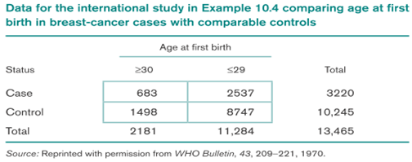
Contingency-Table Method
This is an example of an observed contingency table

Slide 11
Contingency-Table Method
To determine statistical significance, we need to develop an expected table, which is the contingency table that would be expected if there were no relationship between breast cancer and age at first birth—that is, if H0: p1 = p2 were true.
In this example p1 and p2 are the probabilities (among women with at least one birth) of a breast-cancer case and no breast cancer cases, respectively, having a first birth at an age ≥30.

Slide 12
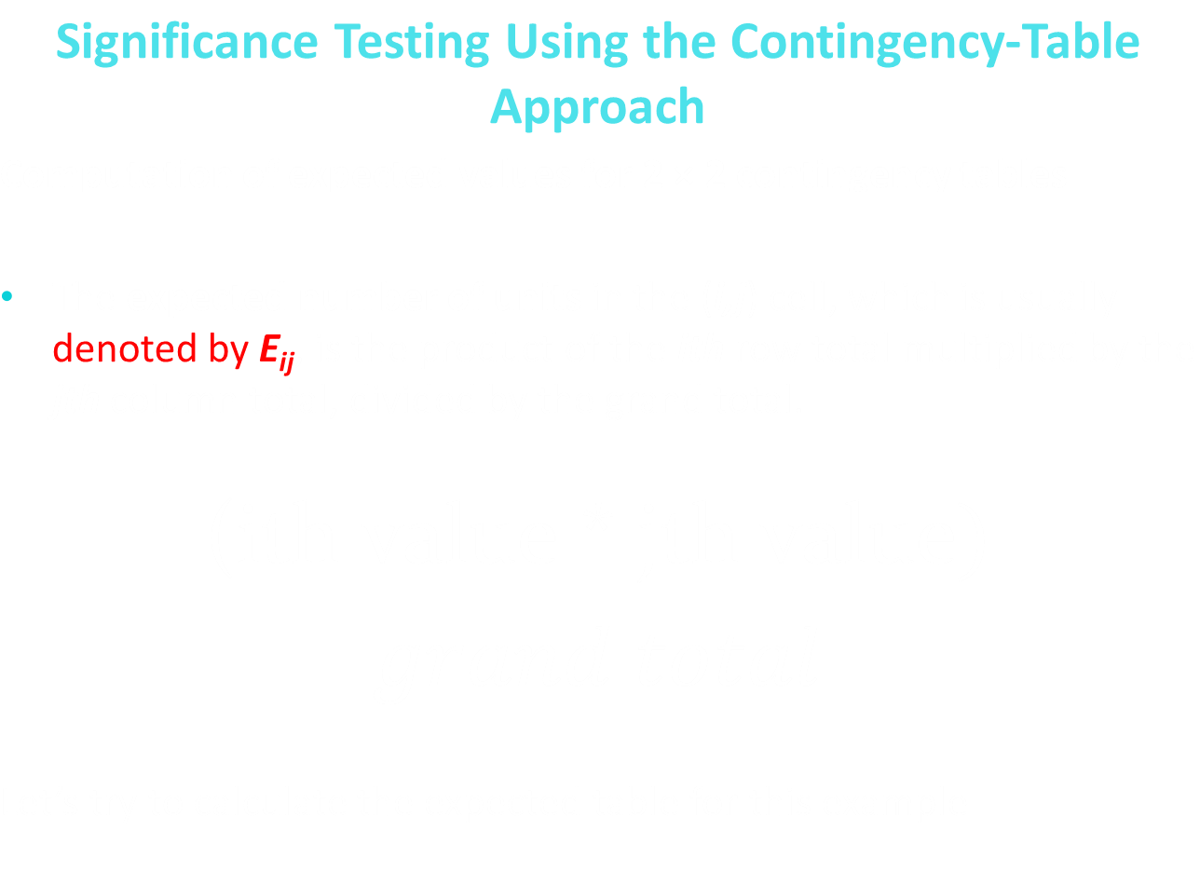

Slide 13
Contingency-Table Method
E11 = expected number of units in the (1, 1) cell = 3220(2181)/13,465 = 521.6
E 12 = expected number of units in the (1, 2) cell = 3220(11,284)/13,465 = 2698.4
E 21 = expected number of units in the (2, 1) cell = 10,245(2181)/13,465 = 1659.4
E 22 = expected number of units in the (2, 2) cell = 10,245(11,284)/13,465 = 8585.6

Slide 14
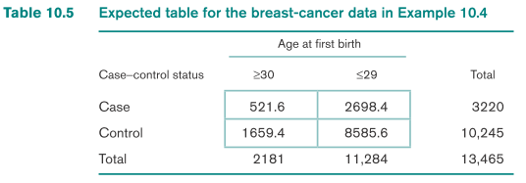
An expected table is a contingency table that would be expected if there were no relationship between parameters that is if
H₀: p₁ = p₂ = p were true.
Expected Contingency table

Slide 15
Contingency-Table Method
Compare the observed table with the expected table.
If the corresponding cells in these two tables are close, then we will fail to reject the null hypothesis;
If they differ enough, then the null hypothesis will be rejected.

Slide 16
Contingency-Table Method
Observed Contingency table
Expected Contingency table
How should we decide how different the cells should be for us to reject H0?

Slide 17
The Chi-Square Statistic
A chi-square statistic is one way to show a relationship between two categorical variables
chi-square test for independence:
A chi-square test for independence compares two variables in a contingency table to see if they are related or associated.

Slide 18
The Chi-Square Statistic
Hypotheses
Null hypothesis: Assumes that there is no association between the two variables (independent).
Alternative hypothesis: Assumes that there is an association between the two variables (not independent).

Slide 19
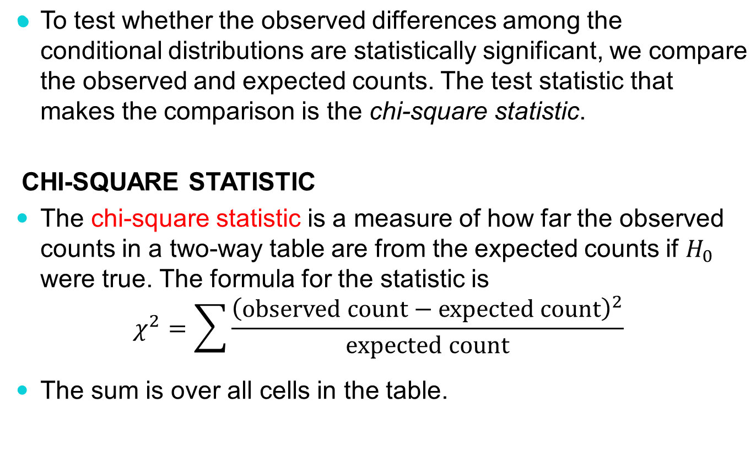
The Chi-Square Statistic

Slide 20
The Chi-Square Statistic
Degree of freedom is calculated by using the following formula:
DF = (r-1)(c-1)
Where
DF = Degree of freedom
r = number of rows
c = number of columns

Slide 21
The Chi-Square Statistic
Degree of freedom is calculated by using the following formula:
DF = (r-1)(c-1)
Where
DF = Degree of freedom
r = number of rows
c = number of columns

Slide 22
Chi-Square Analysis:
P-value
A large chi-square statistic will correspond to small p-value.
If the p-value is small enough (say < 0.05), then we will reject the null hypothesis that the two variables are independent and conclude that there is an association between the row and the column variables.

Slide 23
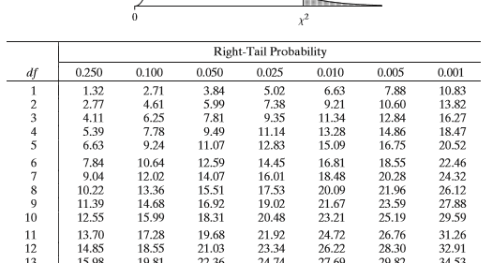
Chi-Square Table

Slide 24
Chi-Square Test: Breast Cancer example
Observed Contingency table
Let’s calculate the chi-square test statistics by hand?
Expected Contingency table
The chi-square test statistics is 78.32

Slide 25
Chi-Square Table
P-value = 0.001
The df = (r-1)(c-1)
df = (2-1) (2-1) = 1
The closest test statistics to 77.89 is 10.83, which has a p-value of 0.001
Conclusion: We reject the null hypothesis, these is a association between breast cancer and age at first birth.

Slide 26
STATISITICAL LAB
CATEGORICAL DATA ANALYSIS

Slide 27
Chi-Square Analysis: USING SAS
PROC FREQ is an essential procedure used primarily for counting, displaying and analyzing categorical type data
It is provide the count and percent of categories for a categorical variable
Code: This code will give you the count and the percentage of the categories for the categorical variable
PROC FREQ DATA=dataset name;
TABLES variable name;
RUN;
Code: preform chi-square test; ( just add /chisq) This will give you the chi-square test statistics and p-value
PROC FREQ DATA=dataset name;
TABLES variable name1*variable name2/chisq;
RUN;

Slide 28
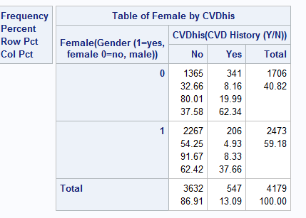
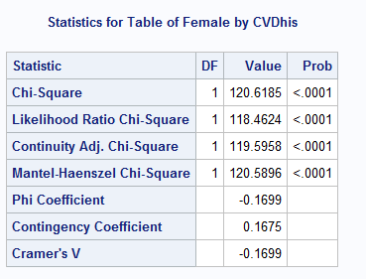
USING TECHNOLOGY: Chi-square example
Is there an association between CVD history
and gender ?
Code:
proc freq data = heart;
tables female*cvdhis/chisq;
run;
Results:
Interpretation: the Chi-squared value is 120.6185 with a p-value = <0.001. This provides evidence to reject the null hypothesis .Thus we can conclude that there is a relationship or association between gender and CVD history
Chi-square test statistics
P-value

Slide 29
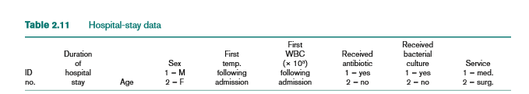
Categorical Data Analysis using SAS:
Import the hospital dataset in the SAS to answer the questions below.

Slide 30

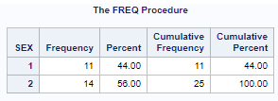
Categorical Data Analysis using SAS
What is the distribution regarding gender in the dataset? Provide a contingency table to show the distribution
Code
Result

Slide 31
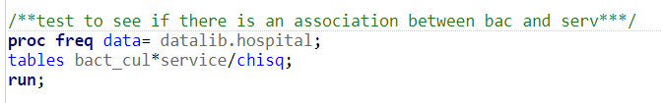
Categorical Data Analysis using SAS
Test whether there is an association between whether a patient received bacterial culture and the service the patient received? Perform a chi-square test and provide the contingency table from the test.
Code

Slide 32
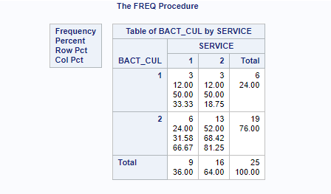
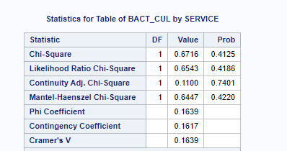
Categorical Data Analysis using SAS
Test whether there is an association between whether a patient received bacterial culture and the service the patient received? Perform a chi-square test and provide the contingency table from the test.
Result
Conclusion: the Chi-squared value is 0.1114 with a p-value = 0.7386. We fail to reject the null hypothesis, there is not enough evidence to conclude that there is a relationship or association between bacterial culture and service received.

